Slide 1
RELATIONSHIPS
AS CONSTRAINTS
Dr. Jose Annunziato

Slide 2
Relationships as Constraints
Many-one relationships have implied constraint
Recall majors in relation between STUDENT & DEPT
Relation implies student has exactly one major
Relational schema must enforce implied constraint
Many-one relationships are implemented by foreign-key on weak side table referencing primary-key of strong side table
Referential integrity satisfies implied constraint
STUDENT
* majors in 1
DEPT

Slide 3
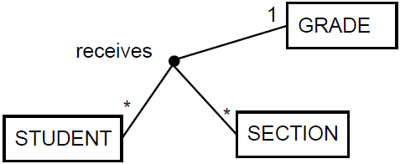
Multi-way Relations Constraints
Consider reification to remove 3-way relation receives between STUDENT, GRADE and SECTION
The 3-way relation implies one grade for a particular student in a particular section

Slide 4
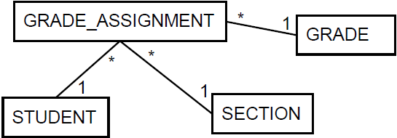
Relationships as Constraints
But when we reify, we lose the implied constraint
GRADING_ASSIGNMENT
STUDENT | SECTION | GRADE
Alice | S1 | A
Alice | S2 | B
Alice | S3 | A
Bob | S4 | B
Bob | S4 | A
Bob | S2 | B
Charlie | S2 | B
Charlie | S2 | A
Charlie | S3 | C
GRADES
A
B
C
STUDENTS
Alice
Bob
Charlie
SECTIONS
S1
S2
S3
S4
Bob has 2 different grades for S4
Charlie has 2 different grades for S2

Slide 5
Reified Class Loses Implied Constraint
The new class diagram states that each grade assignment has a student, a section, and a grade
But class diagram does not disallow (or imply) a student can't have 2 grades for the same section
But was implied in the original class diagram

Slide 6
But We Can Fix It
Similarly, the ENROLL schema we were considering with an artificial key, would have allowed multiple entries with same StudentId and SectionId
ENROLL(EId, Grade, StudentId, SectionId)

Slide 7
But We Can Fix It
We fixed this by removing artificial key and using natural keys as primary (and foreign) keys
ENROLL({StudentId, SectionId}, Grade)
Ensures student can't enroll in same section twice

Slide 8
General Principle
The primary key of a reified table should consist of foreign keys of original many side tables

Slide 9
Limits of Principle
General principle assumes reified table has all foreign keys
Implies class diagram has all original relationships
But, not always true
Might have been removed to eliminate redundancy
Let's look at an example where we remove redundancy, but then we can't enforce implied constraints

Slide 10
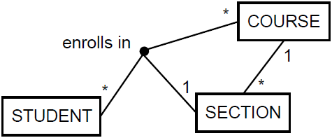
Recall
Recall relationship between STUDENT & SECTION
Consider the following new database requirement
A student can enroll in a section of a course only
if the student has not taken that course before
This forces a 3-way relationship with COURSE
* enrolls in *
* 1
STUDENT
SECTION
COURSE

Slide 11
Reifying can Introduce a Conundrum
Reifying enrolls in produces ENROLL table
Applying principle we get corresponding schema:
ENROLL({StudentId, CourseId}, SectionId)
SECTION(SectId, CourseId)
STUDENT(SId) COURSE(CId)
* 1
STUDENT
SECTION
COURSE
1
*
1 *
* 1
ENROLL

Slide 12
Reifying Introduces a Problem
Per principle, primary key {StudentId, CourseId} enforces many-one constraint
But, ENROLL → COURSE is redundant
We can get same info from ENROLL → SECTION → COURSE
Should remove redundant relationships, otherwise we run risk of inconsistencies
But, if we remove it, can't enforce many-one constraint
Conundrum with no clear solution

Slide 13
No Good Options
If we leave redundant field ENROLL.CourseId then we risk inconsistent data
Inconsistency risk: we can update ENROLL.CourseId with wrong value or different from SECTION.CourseId
If we remove redundant field ENROLL.CourseId then we can't enforce Many-one relationship
Unenforced Many-one constraint: we could insert multiple records with same student and course

Slide 14
Solve at Application Level
Must choose between two evils
Keep redundancy + handle potential inconsistencies
Remove redundancy + handle constraint violations
Deal with it at the application level
Keep redundancy and avoid inconsistency by managing CourseId at app level
Remove redundancy and enforce constraints with assertions

